Slide 1
C372 Payment Technologies
Lesson 03
Separation of Concerns, MVC

Slide 2
Recall

Slide 3
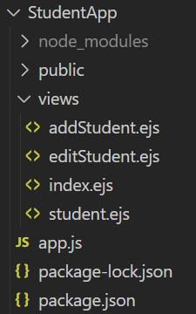
NodeJS Project Folder Structure
Assets such as images, javascript, css should be stored here
Project folder
Dependencies(external libraries or packages) will be installed here
EJS files that contain HTML and embedded JavaScript in this folder
Entry point for the project to run, also contains business logic
Automatically generated when you run npm install for the first time. Locks the version of the packages
Contains meta data about the project(e.g. project name, description), dependencies required by the project, etc.

Slide 4
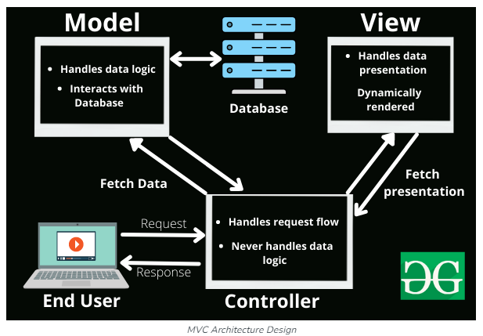
MVC
Recall in C237, we discussed about Model-View-Controller(MVC)
https://www.geeksforgeeks.org/mvc-framework-introduction/

Slide 5
MVC
In C237, we used the template engine Embedded JavaScript(EJS) to help us process and display the views. The EJS files were placed in a folder named views
Model and controller, there was no explicit structuring of this, as all the logic was in app.js.
While the code will still work, as the project grows larger, it can become difficult to manage.
In this module, we will also look at how to organize code for better maintainability and scalability.
https://www.geeksforgeeks.org/mvc-framework-introduction/

Slide 6
Separation of Concerns

Slide 7
Separation of Concerns
Separation of Concerns (SoC) is a fundamental software design principle that promotes organizing a program into distinct sections, where each section addresses a separate concern or responsibility.
A concern in software development can be any distinct functionality or feature, such as business logic, user interface, database interaction, or security.
The primary goal of SoC is to isolate responsibilities within different modules, layers, or classes of an application. This improves maintainability, readability, scalability, and testability.

Slide 8
Separation of Concerns
MVC (Model-View-Controller) is a classic example of the Separation of Concerns (SoC) principle in software architecture.
Model: Handles the data and business logic. It’s responsible for retrieving, storing, and processing data.
View: Manages the presentation layer. It displays data to the user and defines how the UI looks.
Controller: Acts as an intermediary between the Model and View. It handles user input, updates the Model, and refreshes the View.
By separating these responsibilities, MVC makes applications easier to maintain, test, and scale. Each component can evolve independently as long as the interfaces between them remain consistent.

Slide 9
Separation of Concerns
Model: Handles the data and business logic. It’s responsible for retrieving, storing, and processing data.
View: Manages the presentation layer. It displays data to the user and defines how the UI looks.
Controller: Acts as an intermediary between the Model and View. It handles user input, updates the Model, and refreshes the View.
https://www.geeksforgeeks.org/mvc-framework-introduction/

Slide 10
Separation of Concerns
Currently in StudentApp,
  EJS files are already separated in the views folder
  app.js contains the database credentials, handles input, data, business logic
As the project grows larger, it can become difficult to manage.
Including credentials directly in app.js introduces potential security vulnerabilities.

Slide 11
Separation of Concerns
We will be creating the following files/folders in StudentApp to implement the MVC framework
File/Folder | Description
.env | Environment configuration file to store database credentials.
db.js | Contains the logic to connect to the database using the values from .env.
controllers | Folder to store controllers
models | Folder to store models
StudentController.js | Student controller to handle any input, update the student model, and refresh the related views.
Student.js | Student model to handle the data and business logic. It’s responsible for retrieving, storing, and processing student data

Slide 12
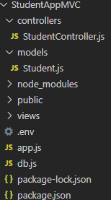
Exercise 1 - StudentAppMVC
Make a copy of the existing StudentApp project and rename it to StudentAppMVC
In StudentAppMVC,
  Create a file named db.js
  Create a file named .env
  Create a folder named controllers
  In controllers, create a file named StudentController.js
  Create a folder named models
  In models, create a file named Student.js
Screenshot your StudentAppMVC project structure and paste in your worksheet.
Your project structure should look similar to the screenshot here

Slide 13
Environment Configuration file
.env stores environment-specific variables such as:
  Database connection strings
  API keys
  Port numbers
  Feature flags
  Secrets or tokens
These variables are loaded into your application at runtime, typically using a library like dotenv in Node.js

Slide 14

Exercise 2 - .env
Copy the code below and paste it into .env file.
Should .env file be uploaded to the cloud?
DB_HOST=localhost
DB_USER=root
DB_PASSWORD=YOUR_PASSWORD
DB_NAME=c237_studentlistapp
Remember to replace the database password with your own.

Slide 15
Exercise 3 - Database Connection
Paste the code here to db.js
const mysql = require('mysql2');
require('dotenv').config(); // Load variables from .env
//Database connection details
const db = mysql.createConnection({
host: process.env.DB_HOST,
user: process.env.DB_USER,
password: process.env.DB_PASSWORD,
database: process.env.DB_NAME
});
//Connecting to database
db.connect((err) => {
if (err) {
console.error('Error connecting to MySQL:', err);
return;
}
console.log('Connected to MySQL database');
});
module.exports = db;
As we are using environment variables, we now do not put the actual database credentials here

Slide 16
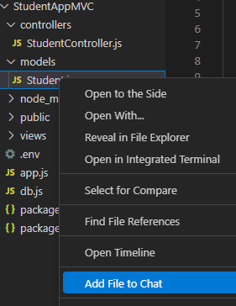
Copilot in VSCode
We will be using Copilot in VS Code to assist us in creating the model and controller.
You will need to be logged in to GitHub in VSCode
Right-click on Student.js
Select “Add File to Chat”

Slide 17
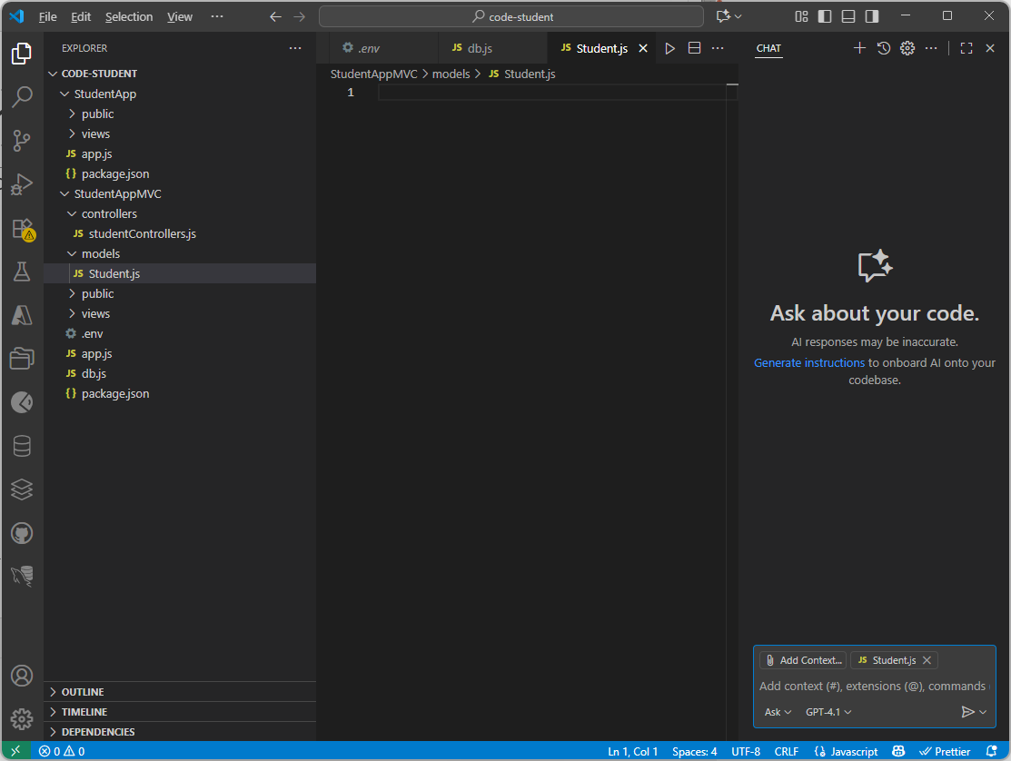
Copilot in VSCode
You will see a chat box appear similar to below

Slide 18
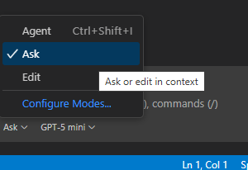
Copilot in VSCode - Modes
Agent Mode
  Purpose: Engage with an AI assistant or agent.
  Functionality: You can ask questions, get help, or receive suggestions from the AI.
  Use Case: Ideal for conversational tasks, guidance, or automation.
Ask Mode
  Purpose: Ask questions or make requests in context.
  Functionality: The AI interprets your input based on the surrounding content (e.g., a document or code).
  Use Case: Great for clarifying, summarizing, or modifying specific parts of a document or interface.
Edit Mode
  Purpose: Directly modify content.
  Functionality: You can make changes manually or instruct the AI to rewrite or restructure something.
  Use Case: Best for refining text, correcting errors, or rephrasing.
For the purpose of the exercise, we will be using the Ask mode for now.

Slide 19
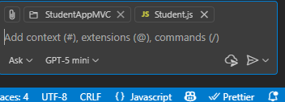
Adding Context
To enhance the quality of results, it's important to provide relevant context. For this exercise, that means including details from the StudentAppMVC project.
  Click on to add context
  Select Files and Folders
  Select StudentAppMVC
Once added, you should see the StudentAppMVC project added as shown below. (Student.js was added earlier when we did Add File to Chat)

Slide 20
Copilot in VSCode - Model
Enter the prompt below into the chatbox to generate code for Student.js model.
Generate a function-based student model for Node.js using the MVC pattern. The model should export an object with methods for common database operations (get all students, get student by ID, add, update, delete). Each method should accept parameters and a callback, and use a MySQL connection from require(‘../db’).
Use SQL queries that match a students table with fields like studentId, name, dob, contact, and image.
Note:
The outcome may differ depending on the model used. Also, we are using the Ask mode.

Slide 21
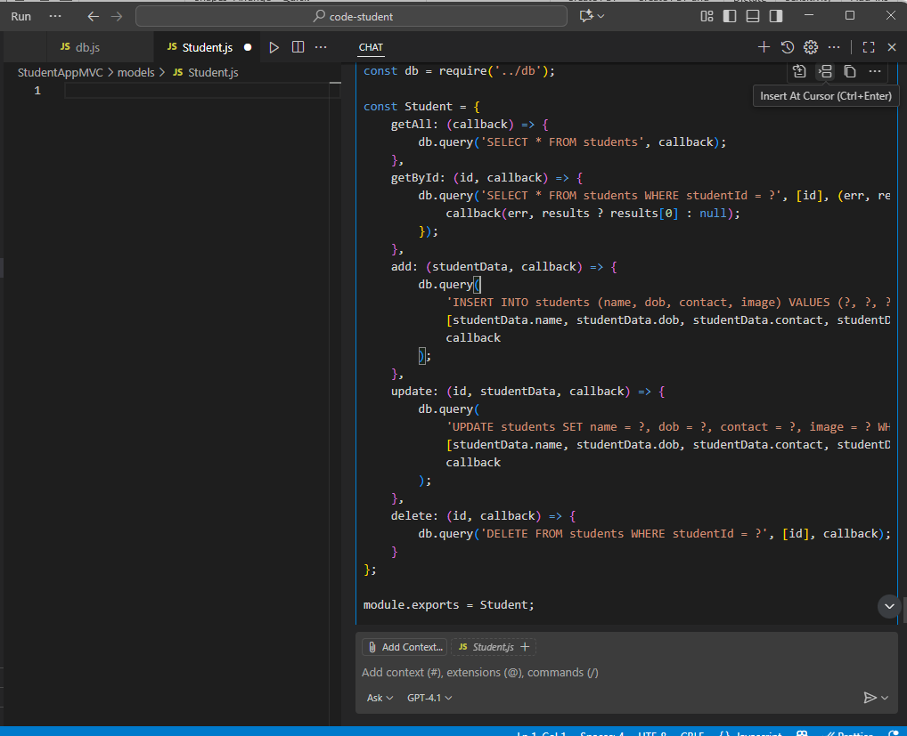
Model
Review the code
Check that Student.js is open
Click “Insert At Cursor”
The code will appear in Student.js
Save Student.js

Slide 22
Controller
Enter the prompt below into the chatbox to generate the code for StudentController.js
Generate a function-based student controller for Node.js using the MVC pattern. The controller should export an object with methods for common operations: list all students, get student by ID, add, update, and delete a student. Each method should accept the standard Express req and res objects, call the corresponding method from the student model (imported from ../models/Student), and handle the response or error appropriately.
Note: You may need to add StudentAppMVC to the context again.

Slide 23
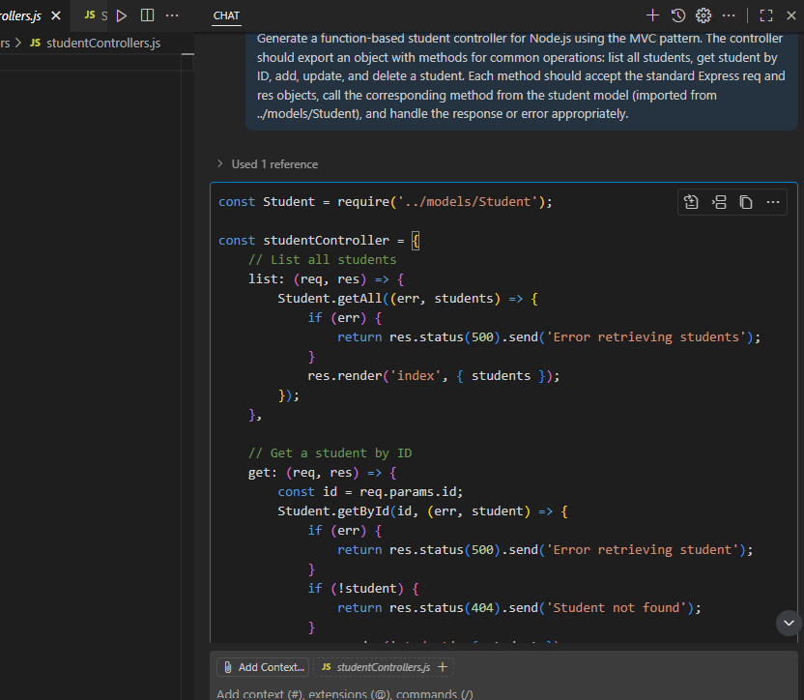
Controller
Review the code
Check that StudentController.js is open
Click “Insert At Cursor”
The code will appear in StudentController.js
Save StudentController.js

Slide 24
app.js
Enter the prompt below into the chatbox to refactor app.js
Update app.js to use the MVC pattern with the function-based student controller and model.
Import the student controller from ./controllers/studentControllers.
Replace all direct SQL queries and database logic in the route handlers with calls to the corresponding controller methods.
Use the controller methods for listing all students, getting a student by ID, adding, updating, and deleting students.
Ensure the routes use the correct HTTP methods and paths, and that file uploads (with multer) are handled for add and update operations.
The controller methods should handle rendering views or redirecting as appropriate.
Remove any unused direct database connection code from app.js.
Note: You may need to add StudentAppMVC to the context again.

Slide 25
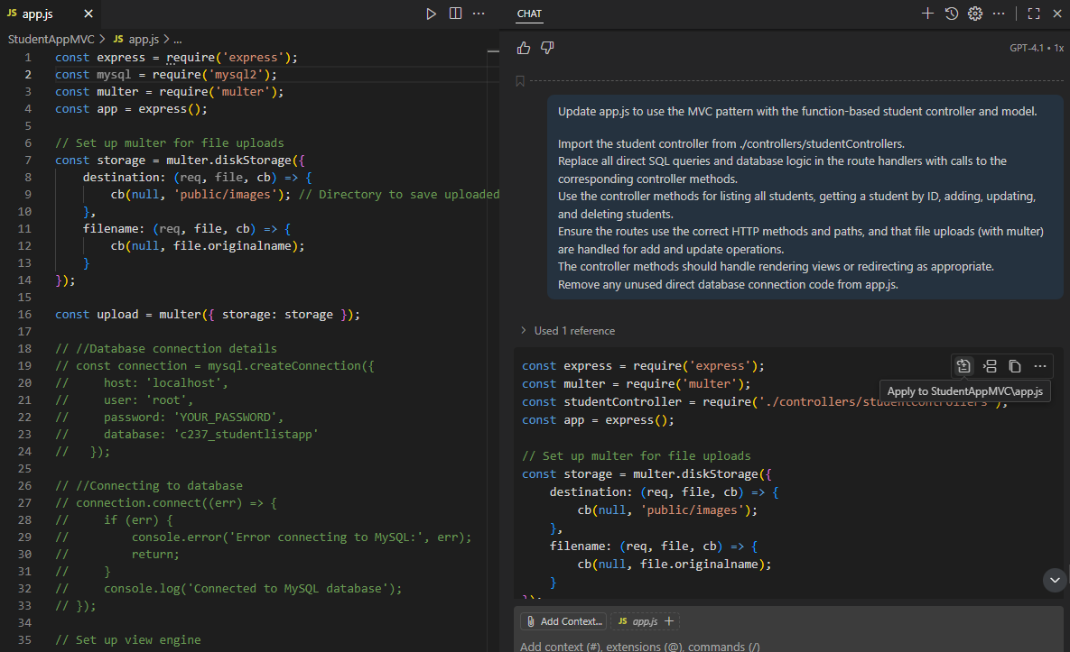
app.js
Review the code
Click on Apply to StudentMVC/app.js

Slide 26
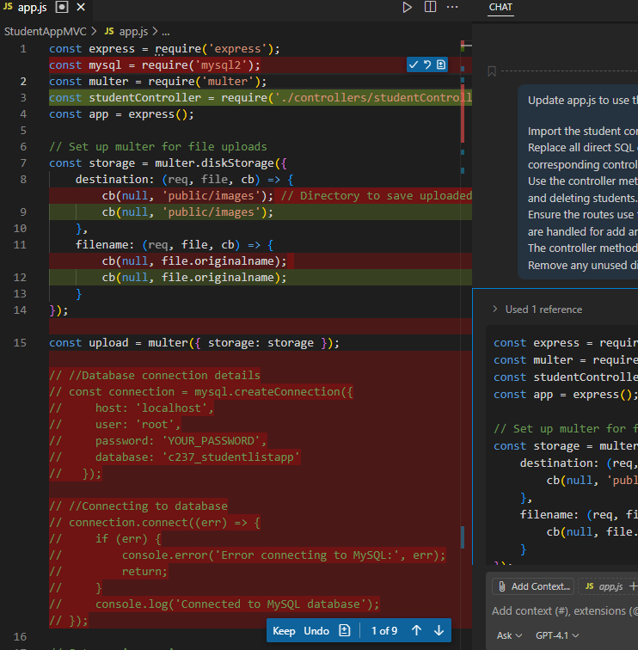
app.js
The lines marked in red will be removed
The lines marked in green will be added
You will be asked to Keep or Undo.
Click Keep.
Save app.js

Slide 27
Exercise 4
Paste the prompt you used to generate the code for:
  Student.js
  StudentController.js
  app.js
For each prompt, summarise the response you recieved.
Was the response correct and aligned with your expectations?

Slide 28
Test StudentAppMVC
In StudentAppMVC, right-click on app.js
Select Open in Integrated Terminal
Since we are using the .env file, we need to install the dotenv library
  npm install dotenv
Run StudentAppMVC
  node app.js
  npx nodemon app.js
Go to your browser: http://localhost:3000/

Slide 29
Exercise 5 - Test StudentAppMVC
Test that you are able to run StudentAppMVC and perform the functions*
Functions | Working (Yes/No – If no, describe the issue)
View all students | yes
View student by ID | yes
Add new student | yes
Update student details | yes
Delete student | yes
*You may get different results depending on what was generated for you using genAi assistance earlier.

Slide 30

Test StudentAppMVC
When updating a student, the page brings us to the display of the student information rather than the form to make updates.*
What might be causing this issue?
*At the point of crafting, this is the issue the code generated had.

Slide 31
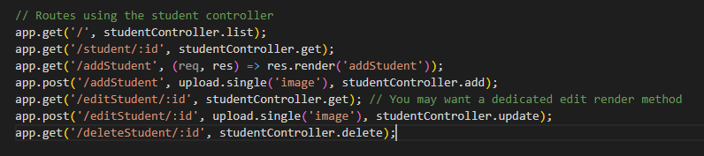
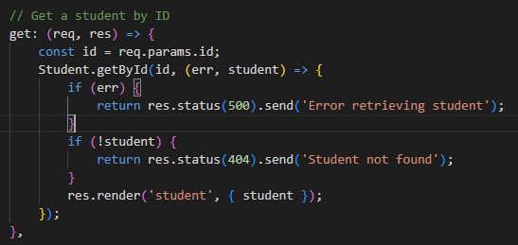
Test StudentAppMVC
In app.js, you will see the following code highlighted below with a comment added earlier when we generated this code.
app.js
studentController.js
The get function in studentController routes us to student.ejs
We need to create a dedicated edit page function as indicated in the comment above

Slide 32
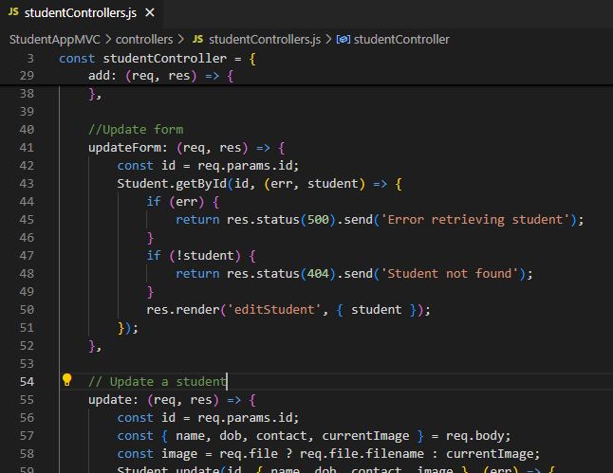
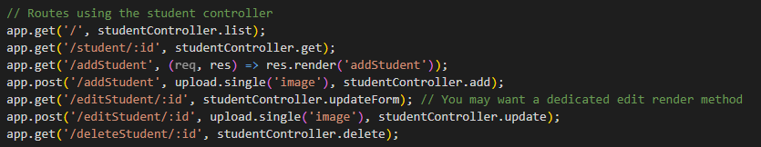
Test StudentAppMVC
In studentController, add in the following code
studentController.js
Observe:
The name of the function is updateForm (Does not currently exist)
We now render to editStudent.ejs
app.js

Slide 33

Test StudentAppMVC
Test StudentAppMVC again
In StudentAppMVC, right-click on app.js
Select Open in Integrated Terminal
Run StudentAppMVC
  node app.js
  npx nodemon app.js
Go to your browser: http://localhost:3000/
Note:
The aim is to open the terminal at the root level of the project. Using these steps help us do that quicker.

Slide 34
Exercise 6
Test that you are able to perform all the functions in the web browser.
Screenshot the working functions into your worksheet
  View all students
  View student by ID
  Add new student
  Update student details
  Delete student

Slide 35
Prompt Review

Slide 36
Prompt Review
Consider the prompt we used earlier:
Generate a function-based student model for Node.js using the MVC pattern. The model should export an object with methods for common database operations (get all students, get student by ID, add, update, delete). Each method should accept parameters and a callback, and use a MySQL connection from require(‘../db’). Use SQL queries that match a students table with fields like studentId, name, dob, contact, and image.

Slide 37
Prompt Review
Generate a function-based student model for Node.js using the MVC pattern. The model should export an object with methods for common database operations (get all students, get student by ID, add, update, delete). Each method should accept parameters and a callback, and use a MySQL connection from require(‘../db’). Use SQL queries that match a students table with fields like studentId, name, dob, contact, and image.
The better we structure our prompts, the better and more accurate our results will be. Providing context to the LLM also helps with better results
Structure:
Goal is defined clearly
Output format is specified
Method signature is outlined
Database type and source provided
Table name and field name provided for SQL queries

Slide 38
Code Review

Slide 39
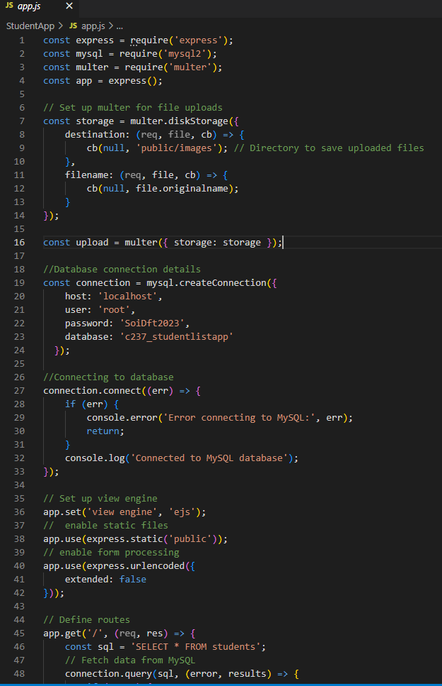
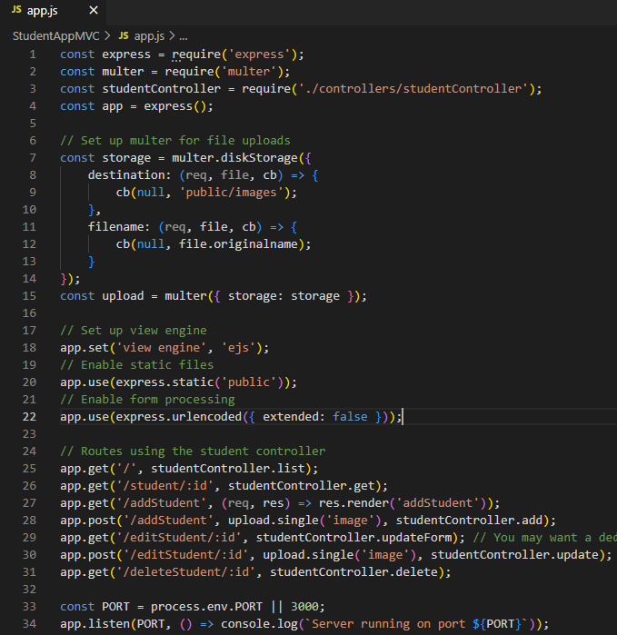
Non-MVC vs MVC
Original app.js ~173 lines of code
app.js ~34 lines of code

Slide 40
Exercise 7
What happened to all the code in the original app.js from StudentApp?

Slide 41
Exercise 7
What happened to all the code in the original app.js from StudentApp?
Previously, app.js file handled everything—from retrieving and storing data to processing user input and updating views.
Now, app.js is streamlined to define routes only. These routes trigger the appropriate controller functions, which in turn interact with the relevant models to handle data operations.

Slide 42
Exercise 8
Using Copilot in VSCode, compare app.js from StudentApp and app.js from StudentAppMVC.
What prompt did you use?
Did you include any context? If so, what was it?
What response did you receive?

Slide 43
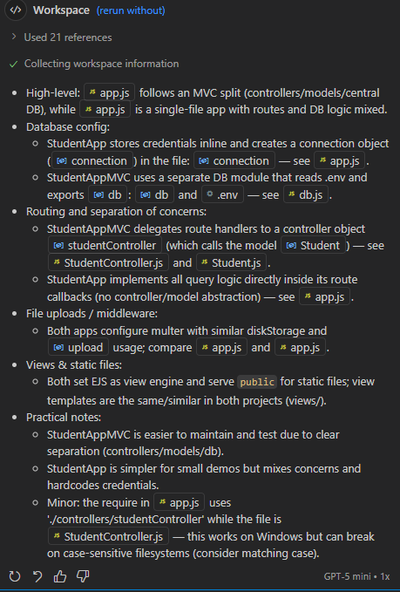
Exercise 8 - Sample Response

Slide 44
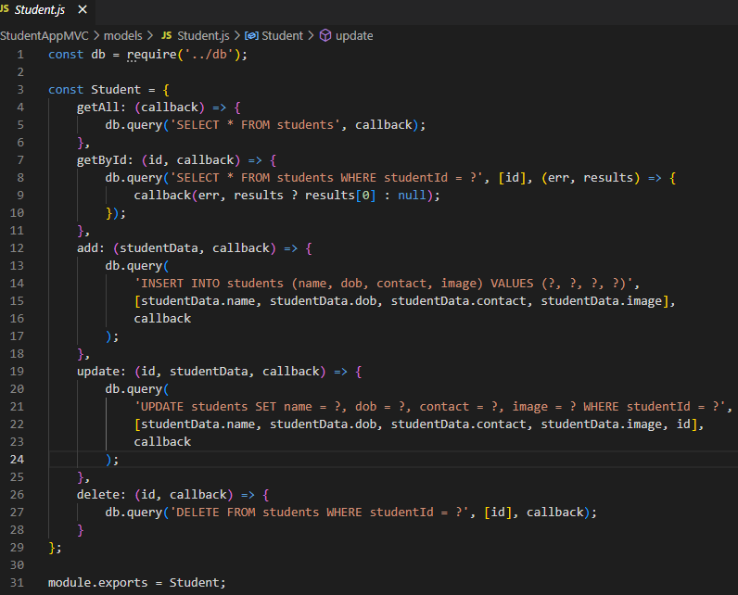
Model – Student Object
Handles the data and business logic. It’s responsible for retrieving, storing, and processing data.
Imports the database connection or configuration from a file named db.js located in the parent directory.
This db object is used to execute SQL queries.

Slide 45
Model – Student Object
Handles the data and business logic. It’s responsible for retrieving, storing, and processing data.
const Student = {…} creates an object named Student that groups all student-related database operations (CRUD functions).

Slide 46
Model – Get all students
Handles the data and business logic. It’s responsible for retrieving, storing, and processing data.
getAll is a method to retrieve all student records from the students table.
When the SQL query is executed, the result (or error) to the provided callback function.

Slide 47
Model – Get student by ID
Handles the data and business logic. It’s responsible for retrieving, storing, and processing data.
getById is a method to fetch a single student by their studentId from the students table.
When the SQL query is executed, the result (or error) to the provided callback function.

Slide 48
Model – Add new student
Handles the data and business logic. It’s responsible for retrieving, storing, and processing data.
add is a method to insert a new student record to the students table using studentData.
When the SQL query is executed, the result (or error) to the provided callback function.

Slide 49
Model – Update student by ID
Handles the data and business logic. It’s responsible for retrieving, storing, and processing data.
update is a method to modify an existing student record matching the given id in the students table using studentData.
When the SQL query is executed, the result (or error) to the provided callback function.

Slide 50
Model – Delete student by ID
Handles the data and business logic. It’s responsible for retrieving, storing, and processing data.
delete is a method to remove a student record by studentId in the students table.
When the SQL query is executed, the result (or error) to the provided callback function.

Slide 51
Model – Export a module
Handles the data and business logic. It’s responsible for retrieving, storing, and processing data.
module.exports = Student; exports the Student object so it can be imported and used in other files (e.g., controllers or routes).

Slide 52
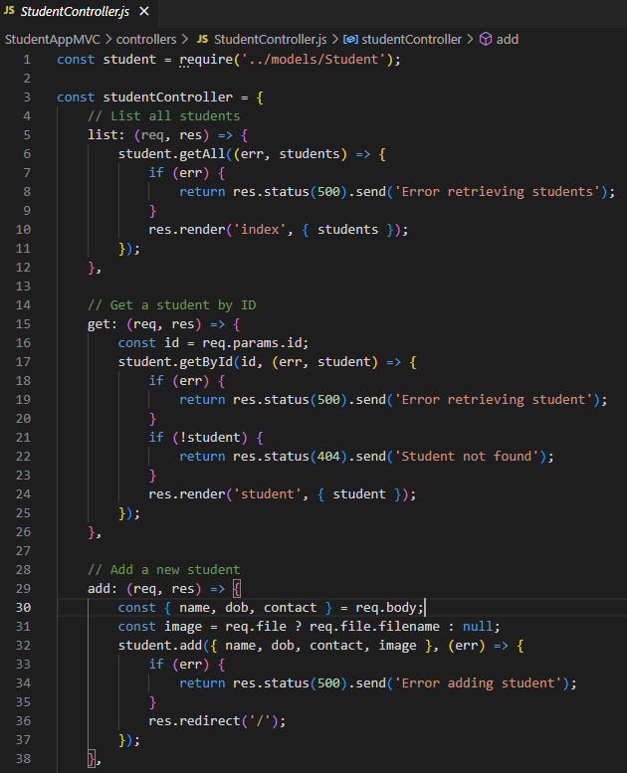
Controller – Import Models
Acts as an intermediary between the Model and View. It handles user input, updates the Model, and refreshes the View.
Imports the Student model, which contains database operations (CRUD) for the students table.

Slide 53
Controller – studentController Object
Acts as an intermediary between the Model and View. It handles user input, updates the Model, and refreshes the View.
Creates an object studentController that defines controller methods for handling HTTP requests related to students.

Slide 54
Controller – List all students
Acts as an intermediary between the Model and View. It handles user input, updates the Model, and refreshes the View.
The list method:
Handles the request to list all students.
Calls student.getAll() to fetch all records.
If there’s an error → sends HTTP 500 with an error message.
Otherwise → renders the index view and passes the students data.

Slide 55
Controller – Get single student by ID
Acts as an intermediary between the Model and View. It handles user input, updates the Model, and refreshes the View.
The get method:
Handles the request to get a single student by ID.
Extracts id from req.params.
Calls student.getById(id).
If error → sends HTTP 500.
If no student found → sends HTTP 404.
Otherwise → renders the student view with the student data.

Slide 56
Controller – Add new student
Acts as an intermediary between the Model and View. It handles user input, updates the Model, and refreshes the View.
The add method:
Handles adding a new student.
Extracts name, dob, contact from req.body.
Checks if an image file was uploaded (req.file), else sets image to null.
Calls student.add() with the new data.
If error → sends HTTP 500.
Otherwise → redirects to / (home page).

Slide 57
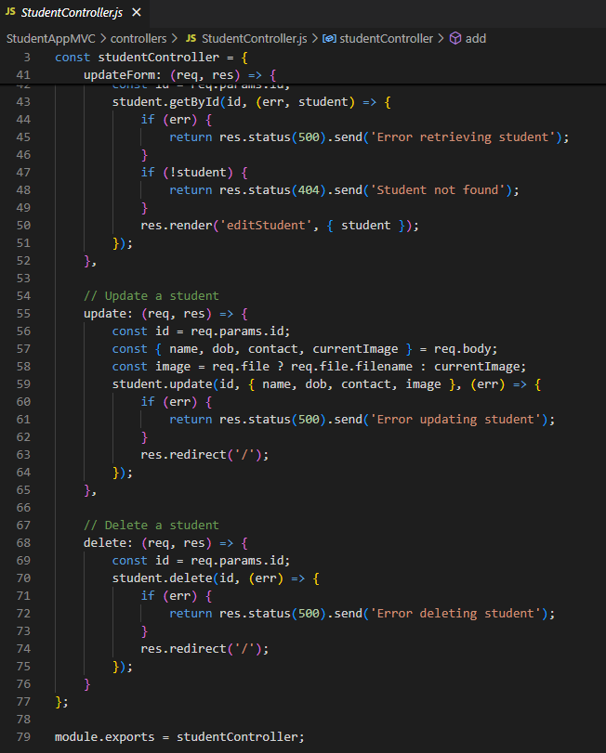
Controller – Update Form
Acts as an intermediary between the Model and View. It handles user input, updates the Model, and refreshes the View.
The updateForm method:
Displays the update form for a specific student.
Gets id from req.params.
Fetches student data using student.getById().
If error → sends HTTP 500.
If student not found → sends HTTP 404.
Otherwise → renders editStudent view with the student data.

Slide 58
Controller – Update
Acts as an intermediary between the Model and View. It handles user input, updates the Model, and refreshes the View.
The update method:
Handles updating an existing student.
Extracts id from req.params and updated fields from req.body.
If a new image is uploaded, use it; otherwise, keep currentImage.
Calls student.update() with updated data.
If error → sends HTTP 500.
Otherwise → redirects to /.

Slide 59
Controller – Delete student by ID
Acts as an intermediary between the Model and View. It handles user input, updates the Model, and refreshes the View.
The delete method:
Handles deleting a student by ID.
Extracts id from req.params.
Calls student.delete().
If error → sends HTTP 500.
Otherwise → redirects to /.

Slide 60
Controller – Export controller object
Acts as an intermediary between the Model and View. It handles user input, updates the Model, and refreshes the View.
Exports the studentController object so it can be used in routes.

Slide 61
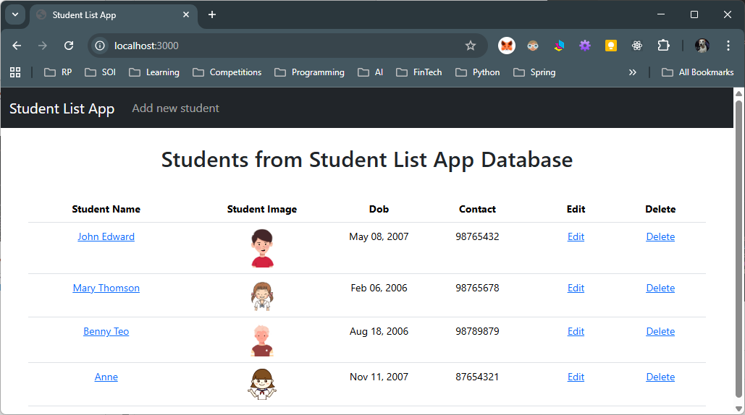
How it Works
1. User enters URL: http://localhost:3000/ which goes to app.js to look got the route ‘/’
app.js
2. The route for ‘/’ is called, which will then call the function list from studentController
StudentController.js
(Controller)
6. The view produces the relevant HTML sent to the client(browser)
5. The controller renders the view
3. The student controller handles the request by calling the list function which calls the student model to fetch the data.
4. The student model queries the database and returns the rows via the model callback to the controller.
Student.ejs
(View)
Student.js
(Model)

Slide 62
CA1 Deliverable
Weeks 2 - 7

Slide 63
CA1 Deliverable
For CA1, you will use the SupermarketApp from C237 as your starting point.
This week, your task is to apply the MVC (Model-View-Controller) design pattern to the SupermarketApp.
Additionally, you must document your work in the file:
C372 Individual CA1 AI Interaction Journal – STUDENTID – STUDENTNAME.docx

Slide 64
Exercise 9
In the Resources folder, SupermarketApp project files and c372_supermarketdb.sql is provided to you.
Setup and test that SupermarketApp works as expected.
Create a copy of SupermarketApp and name it SupermarketAppMVC
Follow the steps you did for StudentAppMVC
Prepare the project structure for SupermarketAppMVC
Document your work in the file:
C372 Individual CA1 AI Interaction Journal – STUDENTID – STUDENTNAME.docx
Sample logins
Admin | User
peter@peter.com 123456 | bobochan@gmail.com 123456

Slide 65
Exercise 10
Create a public GitHub repository
Check in StudentAppMVC and SupermarketAppMVC to your own GitHub Repository.
Fill in the form with your GitHub repository URL
  https://forms.office.com/r/PEKn31juZx

Slide 66
Submissions
POLITEMALL
Worksheet (Individual)
StudentAppMVC project code (Individual, zipped)
SupermarketMVC project code(Individual, zipped)
C372 Individual CA1 AI Interaction Journal – STUDENTID – STUDENTNAME.docx
Upload your deliverables even if it is incomplete before the next session.
You can resubmit by 2359 if there are updates.
SA3.0 (CA1 Interim submission)
SupermarketMVC project code(Individual, zipped)
C372 Individual CA1 AI Interaction Journal – STUDENTID – STUDENTNAME.docx

